Slide 2
DRUGS COST YOU MORE THAN JUST MONEY

Slide 3
Every year on June 26th, the world comes together to observe the International Day Against Drug Abuse and Illicit Trafficking. Established by the United Nations in 1987, this day serves as a global reminder of the urgent need to combat the pervasive issues of drug abuse and illicit trafficking.

Slide 4
WORLD DRUG DAY 2024
International Day Against Drug Abuse and Illicit Trafficking 2024 is observed on June 26. The day is commonly referred to as World Anti-Drug Day. This observance was established by the United Nations General Assembly in 1987 to strengthen action and cooperation to achieve the goal of an international society free of drug abuse.

Slide 5
WORLD DRUG DAY THEME
The theme of World Drug Day 2024 is “The evidence is clear: invest in prevention” The theme of International Day against Drug Abuse and Illicit Trafficking 2024 teaches us the importance of understanding that effective drug policies need to be grounded on science, research, compassion, and full respect for human rights. The day also emphasizes a thorough comprehension of the social, economic, and health consequences of drug use.

Slide 6
SIGNIFICANCE OF WORLD DRUG DAY
The significance of World Drug Day 2024 lies in its ability to raise awareness about the severe consequences of drug abuse and illicit trafficking. These issues not only destroy lives but also disrupt communities, fuel crime, and weaken economies.
According to the United Nations Office on Drugs and Crime (UNODC), around 269 million people worldwide used drugs in 2018, and the numbers have continued to rise. The anti-drug day highlights the global commitment needed to address these challenges through education, support, and rehabilitation.

Slide 7
DRUG TRAFFICKING IN INDIA
It is a serious issue which is posing challenges to the social, economic, and political fabric of the country. The illegal trade of drugs has been a persistent problem, and it continues to evolve and become more sophisticated with new technologies and methods. The emergence of darknet markets and increased use of maritime routes has posed new challenges in the fight against drug trafficking in India.

Slide 9
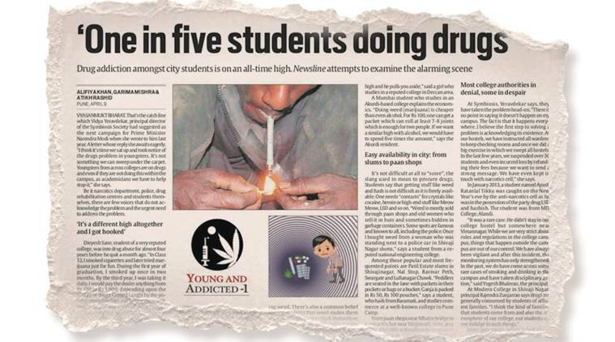
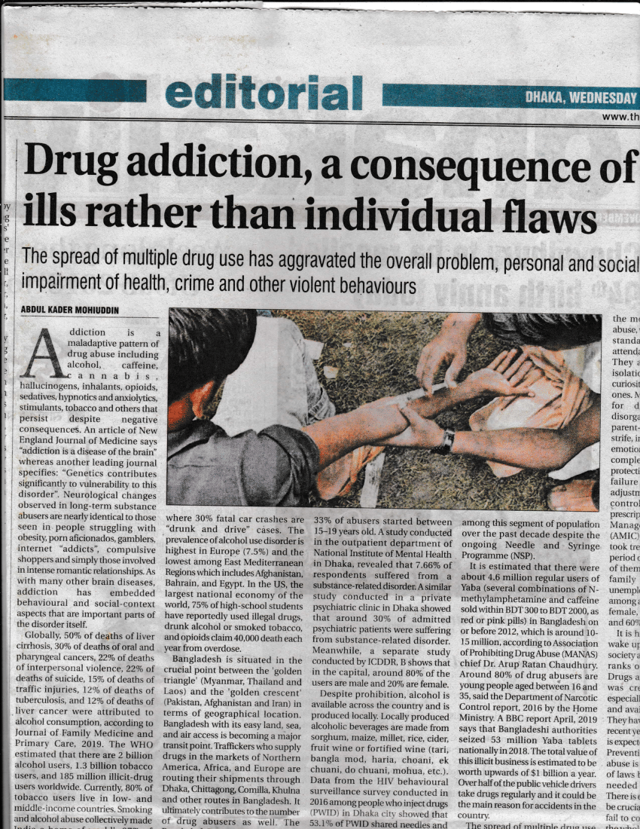
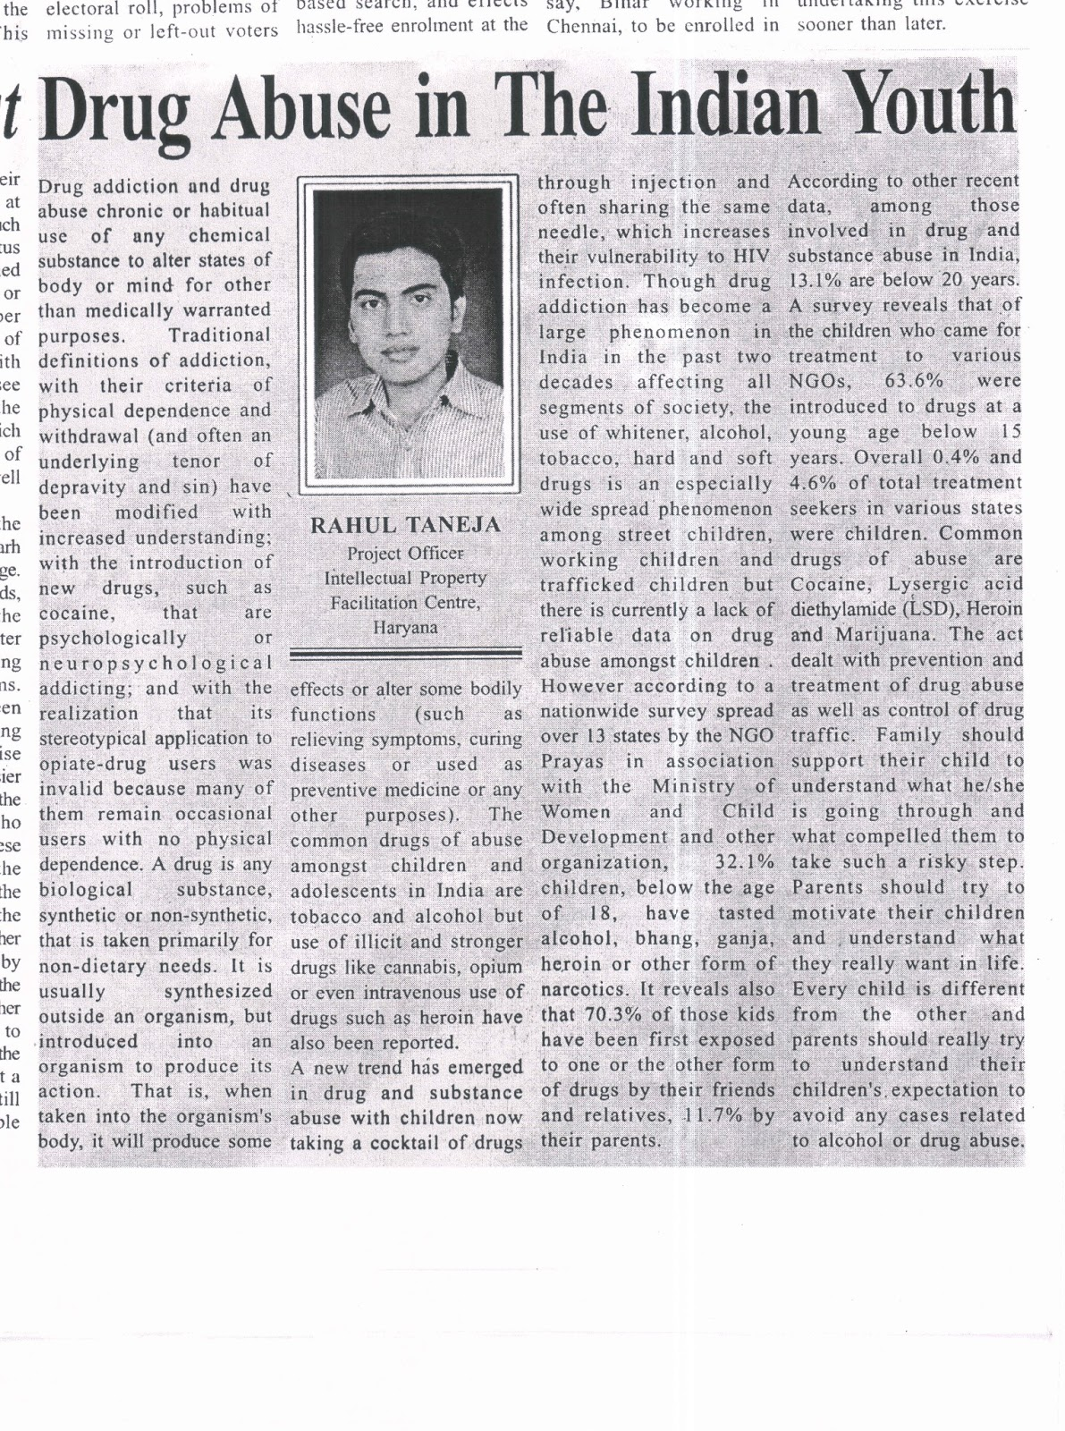
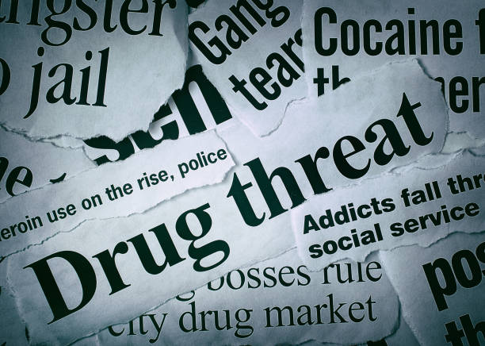
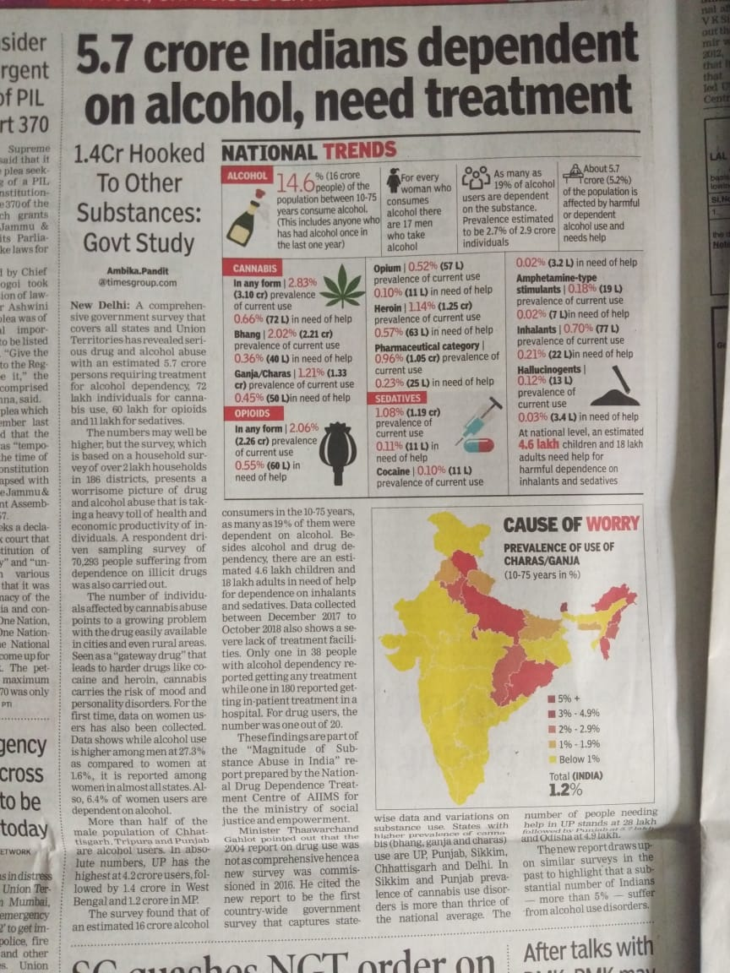
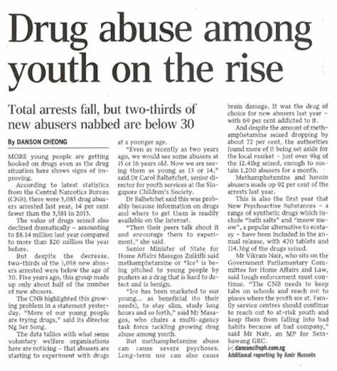

Slide 10
FACTS AND STATISTICS OF DRUG ABUSE IN INDIA
India is one of the world’s largest opiate markets in terms of users and is vulnerable to increased supply from Afghanistan.
Punjab and Himachal Pradesh are leading in India’s epidemic of opioid users, while Gujarat is now the third worst state in terms of drug overdose deaths.
According to the Narcotics Control Bureau (NCB)’s latest annual report 2023, drug trafficking through sea routes in the Arabian Sea and the Bay of Bengal accounts for around 70% of the total illegal drugs smuggled into India.

Slide 11
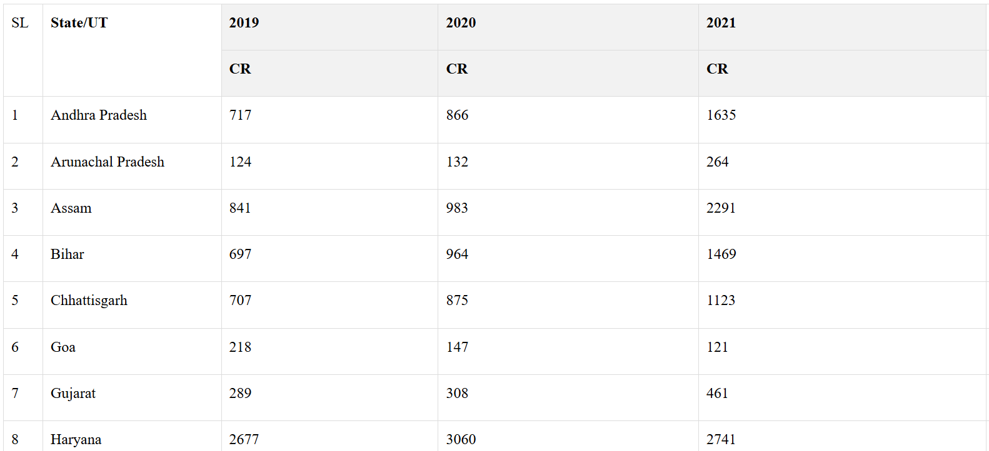
DRUGS CASES IN THE COUNTRY

Slide 12
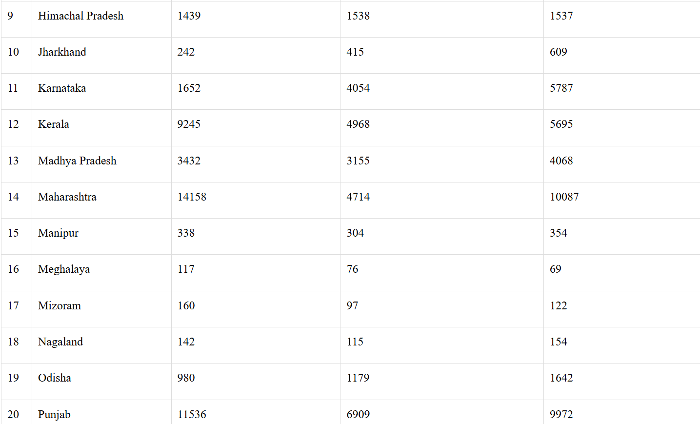

Slide 13
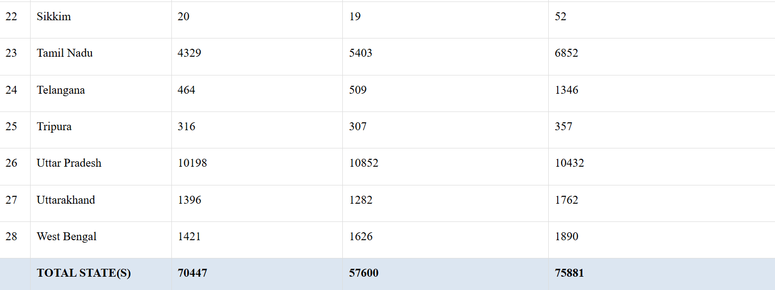

Slide 14
REASONS BEHIND DRUG TRAFFICKING IN INDIA
Geographical Location: India’s location sandwiched between the “Golden Crescent” and “Golden Triangle” regions, which are major drug-producing areas, makes it vulnerable to drug trafficking.
Porous Borders: India shares borders with several countries that are known for drug production and trafficking, and these borders are often poorly guarded and easily penetrated by smugglers.
Large Population: India has a large population generating a high demand for drugs, both for recreational and medicinal purposes.
Lack of awareness: People lack awareness about the dangers of drug abuse.
Corruption: Corruption among law enforcement agencies and government officials allows drug traffickers to operate with impunity.

Slide 15
SO LET’S SAY
NO
TO DRUGS

